Slide 1
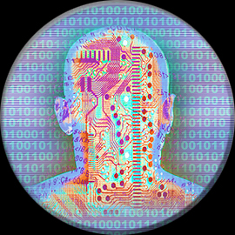
Multidimensional / International Enterprise Project Management
Part III
Teams – Communication
Notes:
IEPM Deuxieme partie
jhk

Slide 2

How can we get the best out of
International Teams ?
Many methodologies exist – but one has proven its efficiency : the Jung – Meyers one.
According to Jung's typology, all people can be classified using three criteria:
    Extroversion – Introversion
    Sensing – Intuition
    Thinking - Feeling
Isabel Briggs-Myers added the fourth criterion:
4. Judging – Perceiving
2 – Get your MBTI type
http://www.humanmetrics.com/cgi-win/JTypes2.asp
Notes:
La question est ;comment tirer le meilleur parti d’éauipes internationales ?
La théorie MBTI est une des théories. Elle est largement utilisés

Slide 3
The four axis
Extroversion – Introversion. The first criterion defines the source and direction of energy expression for a person. The extrovert has a source and direction of energy expression mainly in the external world while the introvert has a source of energy mainly in the internal world.
Sensing - Intuition The second criterion defines the method of information perception by a person. Sensing means that a person believes mainly information he receives directly from the external world. Intuition means that a person believes mainly information he receives from the internal or imaginative world.
Thinking - Feeling The third criterion defines how the person processes information. Thinking means that a person makes a decision mainly through logic. Feeling means that, as a rule, he makes a decision based on emotion.
Judging - Perceiving The fourth criterion defines how a person implements the information he has processed. Judging means that a person organizes all his life events and acts strictly according to his plans. Perceiving means that he is inclined to improvise and seek alternatives
Notes:
4 axes de mesure:
Introversion / Extraversion : selon que l’on dirige son énergie vers le dedans ou vers le dehors
Capteurs d »information au dehors ou au-dedans
Prise de décision rapide ou réfléchie
Habilité à organiser le monde autour de soi

Slide 4
MBTI* theory : overview
E / I S / N T / F J / P
Energy
inside/outside
Information
Processing &
Decision making
Information
Implementation
Information
perception
In France, Meyers-Brigg Type Indicator theory is a registered mark of the OPP Company
Notes:
Ces graphiques reprennent ces éléments.
Nota les lettres en anglais rajoutent un élément de complexité.

Slide 5
Who are you ? …
Who, do think, people think you are ?
Extravert
Is sociable, relaxed, trustful action-oriented
Sense
Plays with the 5 senses, factual, practical, realistic, all-day-the-same style
Thinking
Is logic, self-persuaded, cold, analyst
Jugding
Plans, decides, is autonomous, is concentrated
Introvert
Is reserved, reflexive, reticent in public, concentrated, solitary.
iNtuitif
Plays the 6th sense, has got vision, innovation, inspiration, and even impatience
Feeling
Is friendly, equitable sensitive, and even influenceable
Perceiving
Is curious, spontaneous, tolerant, flexible.
Notes:
Ces 16 types sont habituellement également répartis
Une bonne équipe est une équipe mixée

Slide 6
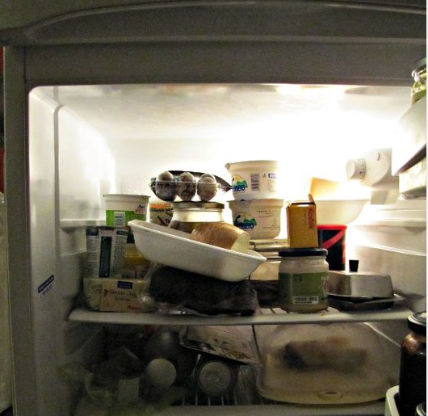
The sixteen types
The different combinations of the criteria determine a type. There may be sixteen types. Every type has a name (or formula) according to the combination of criteria. For example:
ISTJ
Introvert Sensing Thinking Judging or
ENFP
Extrovert INtuitive Feeling Perceiving
Notes:
D’où on déduit 16 types

Slide 7
Now, which mix of these 16 Types do we have in this room ??
Artisans
  Composers ISFPs
  Crafters ISTPs
  Performers ESFPs
  Promoters ESTPs
Guardians
  Inspectors ISTJs
  Protectors ISFJs
  Supervisors ESTJs
  Providers ESFJs
Rationals
  INTPs Architects
  INTJs Masterminds
  ENTPs Inventors
  ENTJs Fieldmarshalls
Idealists
  INFJs Counsellors
  INFPs Healers
  ENFPs Champions
  ENFJs Teachers
Notes:
Example d’une promotion dakaroise. Une bonne équipe !

Slide 8









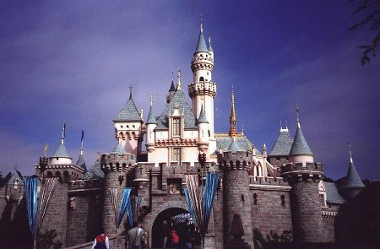
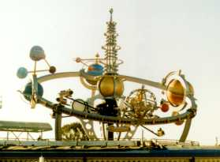
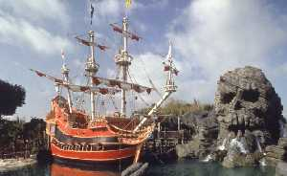
The four groups in other known areas
Artisans
Guardians
Idealists
Rationals
Notes:
On retrouve ces 16 types dans de nombreux autres repères sociaux.

Slide 9

How to use it ?
It may help you to identify your general style and your usual style in certain fields of activity (business, education, communications, conflicts): « know yourself »
It may help you behave in a team : know yourself, know your team. Anticipate reactions. Improve efficiency : « know others »
Notes:
Cela permet de mieux vous connaître, et de mieux connaître vos équipes

Slide 10

Limitations
Should be done / followed by psycho/socio professionals
Risk for personal trouble
Risk for Team blocking
Not a hard science
Just an indicator among others
Notes:
Attention aux perturbation posibles sur les individus

Slide 11

More..
Know your personal style
Understand changes in lifetime (teens – forties)
For each of the 16 types:
  Dominant function
  Achilles' heel
Assignment on team performance
http://www.humanmetrics.com/cgi-win/JTypes2.asp
Notes:
Le style change peu au cours d’une vie, sauf au cours de l’adolescence ou de la quarantaine

Slide 12
MBTI Assignement :
Group in teams
Exchange about your MBTI types
Understand strenghs and weaknesses
Assign roles based on MBTI types
Present in 5 minutes
Notes:
Exercice sur MBTI.

Slide 13
Another model: the Porter model
Colors – groups
RED: Assertive Directing
BLUE: Altruistic Nurturing
GREEN: Analytic Autonomizing
HUB: Flexible Cohering
Notes:
D’autres modèles existents, comme celui de Porter.
On y met en évidence les personnes capables de se ranger à certains types le temps
d’une négociation.

Slide 14
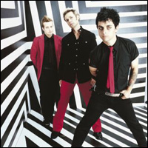
Getting the best of Project teams
Coach/ Manager/ Leader
Notes:
L’entraineur, le chef, le dirigeant.

Slide 15
There is no « I » in Teams!
Project Charter Objectives:
- Establish Trust
- Establish strong base principles
- Define the rules for Team performance
Facilitate new members integration
Encourage empowerment
- Stop information évaporation
- Have the team feel concerned with the goals & objectives
Possible Roadblockers / Inhibitors :
Work rules / habits
Country Usage
Time zone
Language
Culture
Religion
…
Notes:
Une équipe ne laisse pas de place à l’égoisme.

Slide 16
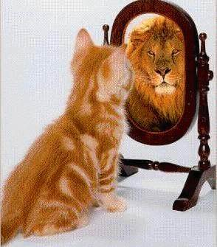
Performance is…
« your style »
(C + E)
m
P =
* M
I
Performance
Competence
Experience
Motivation
Inhibitors
mental (the most powerful : be a winner !)
Notes:
Cette formule met en évidence l’importance du mental : un mental de gagnant est
Un atout dans la performance générale d’ un individu ou d’une équipe.

Slide 17
The Coach…
The four levels of management
Participative
Persuasive
Dissuasive
Directive
motivates the team
listens to individuals
Coaching at reebok video
The Leader…
inspires a vision / a future
innovates and takes risks
federates the team: motivates and animates
Negotiates: to influence a decision
Inspires confidence (with the int & ext.)
Asks "why"
Leads
The Manager…
Manages the short term
builds
administrates
obtains concrete results in line with expectations
asks "how" and "when“
controls
Les gendarmes video
Steve ballmer video
Notes:
Chacun des roles est necessaire. Il faut les connaître et savoir les appliquer en fonction
De la situation.

Slide 18
Mentor & Mentee : the new frontier
Mentoring…..An Example
In Uganda, farmers pair the young beginner ox with an older ox. The two oxen are lied together with a special harness. The device is called a training yoke – and it is configured to make sure the older ox pulls most of the burden. The older ox has the control. If the farmers don’t do that, the younger ox tends to go too fast or too slow. The older ox has the control, so it’ll go at the right pace. The younger one must work at the same pace. The young ox learns from the experience of “walking alongside.” Can you see the wisdom in that from a mentoring standpoint?
If you’ve never mentored before, keep this illustration in mind in the days and years ahead. It will begin to have special relevance as you interact with mentees.

Slide 19
What should be your management style?
High
Direct
Lead
Achieve the task
Delegate
Coach
Low
High
Enhance the Relationship
Mr Distance management video
Mrs Distance management video
Notes:
Sachez adapter votre style de direction à la situation
RIGHT HAND STYLE - If somehow we can leave the left hand side of the chart and find time for the right side we can expect a return by having better relationships

Slide 20
Power & Management styles
Types of Power
Legitimate (Derives from the hierarchical position in the organization, or from the degree of control which is conferred to her/im)
Coercitive (based on the fear of subordinated consequences of errors)
Incitating (based on willing to reward. Depends on the position and/or the delegation given)
Expert (can be only exerted by people who get esteem because of her/his charisma / competence / experience...)
Indirect (when the authority is given on behalf of someone else, which has already got authority)
Management Styles
authoritary: known objectives, supposes adhesion
combative: impassioned and impatient, everything is cause for fight
reconciling: friendly, pleasant, with an obsession: the team
divider: strategy to reign on the group, centralizer
grateful: bases the performance on the reward
'To a man with a hammer, everything looks like a nail,' Mark Twain
Notes:
La puissance du chef repose sur plusieurs aspects

Slide 21
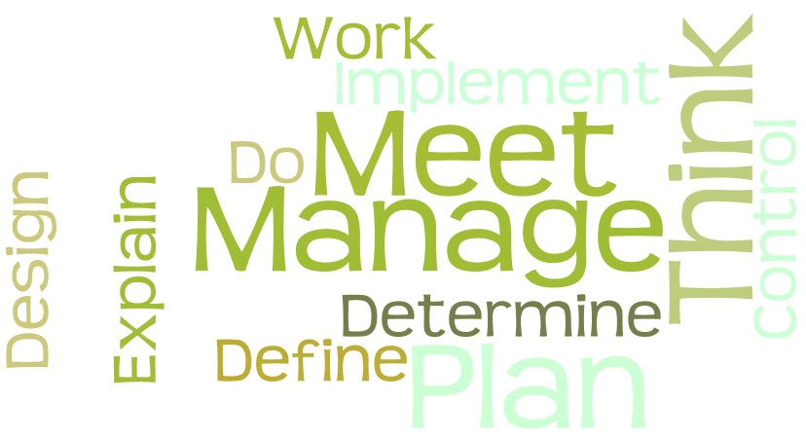
Cloud of words – mgt style1
Courtesy Vicky Flaherty, IBM

Slide 22
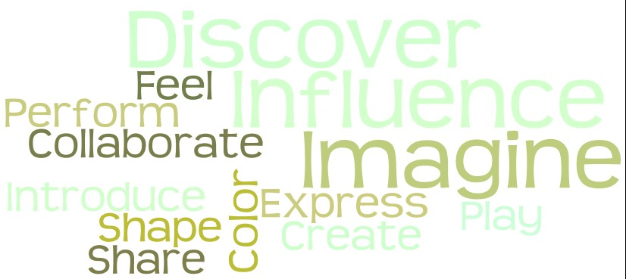
Cloud of words – mgt style2
Courtesy Vicky Flaherty, IBM

Slide 23
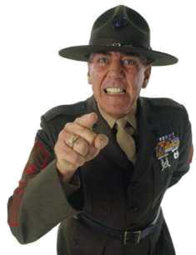
Emotional Intelligence
You don't lead by hitting people over the head – that's assault, not leadership.
- General Dwight D. Eisenhower
It is by no means enough that an officer be capable... No meritorious act of a subordinate should escape his attention... Conversely, he should not be blind to a single fault in any subordinate and punish sparingly in private
- John Paul Jones
Courtesy John F. Jones, MBA, PMP® IBM Executive Certified PM

Slide 24


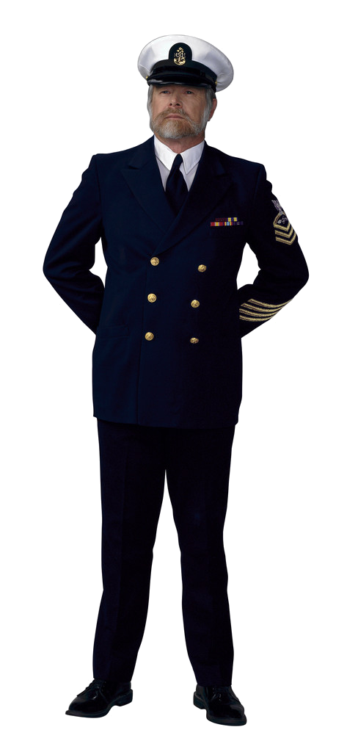
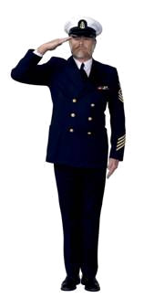

Empowerment - The 3 D’s
Chief, let’s get this done by this time…
Yes, Sir
Sailors, this is what we need to do…
1 - Decide
2 - Delegate
3 - Dissapear
Courtesy John F. Jones, MBA, PMP® IBM Executive Certified PM

Slide 25

Motivation quotes
"Only the mediocre are always at their best." (Jean Giraudoux)
"If everything's under control, you're going too slow." (Mario Andretti)
"I don't know the key to success, but the key to failure is to try to please everyone. (Bill Cosby)
"Education's purpose is to replace an empty mind with an open one" (M.S. Forbes)
"Don't limit your challenges - challenge your limits." (Unknown)

Slide 26
The Project Manager should..
Provide leadership
Define Direction
  Develop Strategy
  Communicate her/his vision
  Motivate and inspire,
  transmit energy.
Negociate
  Exchange with others
  Reach consensus or agreement
- Communicate
  80% of the time
- Solve problems
  Define problems
  Identify solutions
  Make a decision
Influence the organisation (lobbying)
  make things happen
Be available all times
Be challenging
Consider that whatever is not forbidden is possible
Delegate but control
Show the example
Don’t neglect the details
Action 40 to 70% of the time
Kiss but don’t try to be loved
Notes:
Ce qu’un PM doit savoir faire..

Slide 27




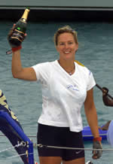
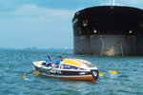
Creating an impression by ‘Choosing your Attitude’
What was Debra's routine on board?
0500 hours Wake up call
0530 hours Row 1
0730 hours Breakfast
0830 hours Row 2
1030 hours Mid morning break
1130 hours Row 3
1330 hours Lunch
1500 hours Row 4
1700 hours Tea break
1800 hours Row 5
2000 hours Dinner
2100 hours Row 6
2230 hours Night break
2300 hours Row 7
0100 hours Secure boat
0130 - 0500 hours Sleep (waking every 30 mins to check for passing ships)
0500 hours - Wake up call
Notes:
Il faut savoir créer son image – et s’y tenir.
£100K cost, BURN IT AS FUEL - Just married, others rowers strangely critical, ‘burn it as fuel’ great quote and attitude
PROFESSIONAL ROWER Husband is a professional rower, after 2 days had to call for help, deep fear of ocean surfaced
3.5 MONTHS He was rescued and Debra carried on, 6 weeks turned into 3.5 months and she found her attitude was the critical element that kept here going SOUTHERLY ROUTE Southerly route caused a bigger issue than the reduction in rowing power
OTHER SOLOS GAVE UP The 2 other other duals that became solos gave up.
CYA is a great phrase.
NO 22 YOUR TIME IS UP - She almost beat the two man Scottish crew by 1 day
Yes – What were the 2 man Scottish crew doing out there’

Slide 28
Create an impression by pro-actively identifying who you need a relationship with
Ask for an organisation chart
List out who you need to know and who needs to know you
Have a plan to meet them face to face
Have a realistic achievable objective for each meeting
Recognise the meetings will vary in content and attendance and duration
Like most investments the value will be long term rather than immediate
The first meeting should never be a crisis or your coverage has been too late
The more senior contacts will be looking at your
  Credibility, Attitude, Reliability and Responsiveness (see next page)
Notes:
Il faut définir avec qui on doit entrer en relation de manière proactive.
F2F MEANS A LOT - Maybe your only objective is to meet up – that alone is an achievement

Slide 29
Use emotion to print on memory during a first business meeting
Classical:
  Know the Customer web pages
  Know the interviewer’s CV
  Show you have read the last press communiqués
  Mention the figures from the Customer’s leaflet
  Leave your own leaflet before you
  (he will forget you soonly ! )
Special
  Check the adress of the meeting
  Look for history about this address
  Know everything about the name of the street
  Manage to mention it in a natural way
  The day after, send a manuscript letter with some precision about this street, include a leaflet.
  (your visit will be remembered)
" There is little difference between one man and another – but this difference is everything" William James
Oomark archive

Slide 30
Client Relationship Summary in terms of creating an impression
Credible, Attitude, Reliable & Responsive
Client
Programme Mgr
Chief Information Officer
Sponsor/
Business
Director
Business
Unit Chief Executive
Dialogue in progress
Daily
Weekly
Monthly
Quarterly
Recognises my delivery capability
Yes
Yes
Yes
Yes
Invites accepted to ‘events’
Yes
Yes
Declined
Yes
Values my advice
Yes
Tends to have own view
Yes
Yes
Extends my contract
Yes
Signs
Supports
Supports
Notes:
Il faut planifier la fréquence avec laquelle on doit rencontrer tel ou tel
VALUABLE PBC DATA This is an actual example from a recent project of how the relationship map looked

Slide 31
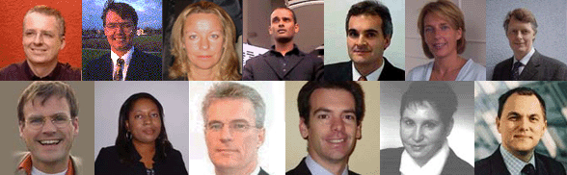
Multi-cultural & -generational Management
Minds are like parachutes. They only function when they are open. -Sir James Dewar, Scientist (1877-1925)
NIT – NIT MOY GARABAM (man is man’s remedy)
NIT DOU NEBOU KHELAM (you cannot hide from your own spirit)
…
Notes:
Gestion d’équipes multiculturelles

Slide 32
Hofstede Cultural dimension theory
power distance (the degree of inequality among people which the population of a country considers as normal)
individualism versus collectivism (the extent to which people feel they are supposed to take care for or to be cared for by themselves, their families or organizations they belong to)
masculinity versus femininity (the extent to which a culture is conducive to dominance, assertiveness and acquisition of things versus a culture which is more conducive to people, feelings and the quality of life)
uncertainty avoidance (the degree to which people in a country prefer structured over unstructured situations)
long-term versus short-term orientation (long-term: values oriented towards the future, like saving and persistence - short-term: values oriented towards the past and present, like respect for tradition and fulfilling social obligations)
Jan 2008, http://www.valuebasedmanagement.net/methods_hofstede.html

Slide 33
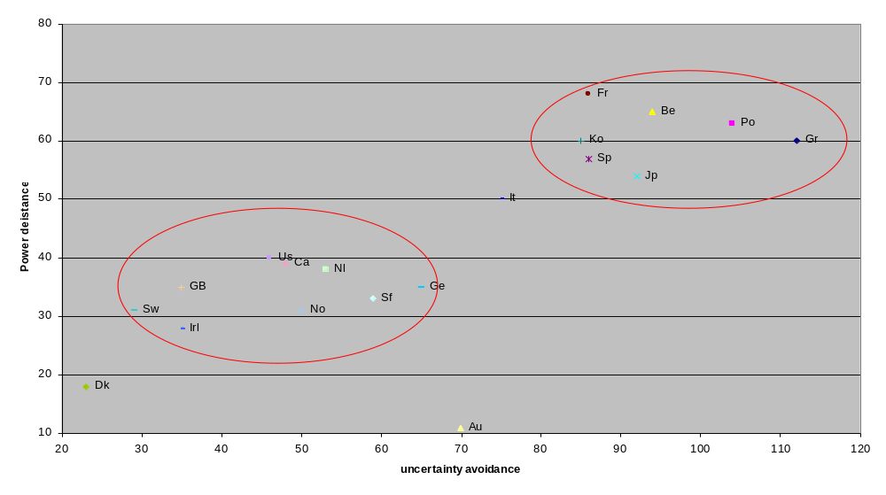
Hofstede’s Power Distance and Uncertainty Avoidance - a result of history
Power distance
Source Prof. A Rys

Slide 34
Diversity is a value
A good team is a team with diverse skills, styles, attitudes, mindsets, so it can react in front of diversity, and add value within and without the team.
« The Company is committed to creating a diverse environment and is proud to be an equal opportunity employer. All qualified applicants will receive consideration for employment without regard to race, color, religion, gender, gender identity or expression, sexual orientation, national origin, genetics, disability, age, or veteran status. »

Slide 35
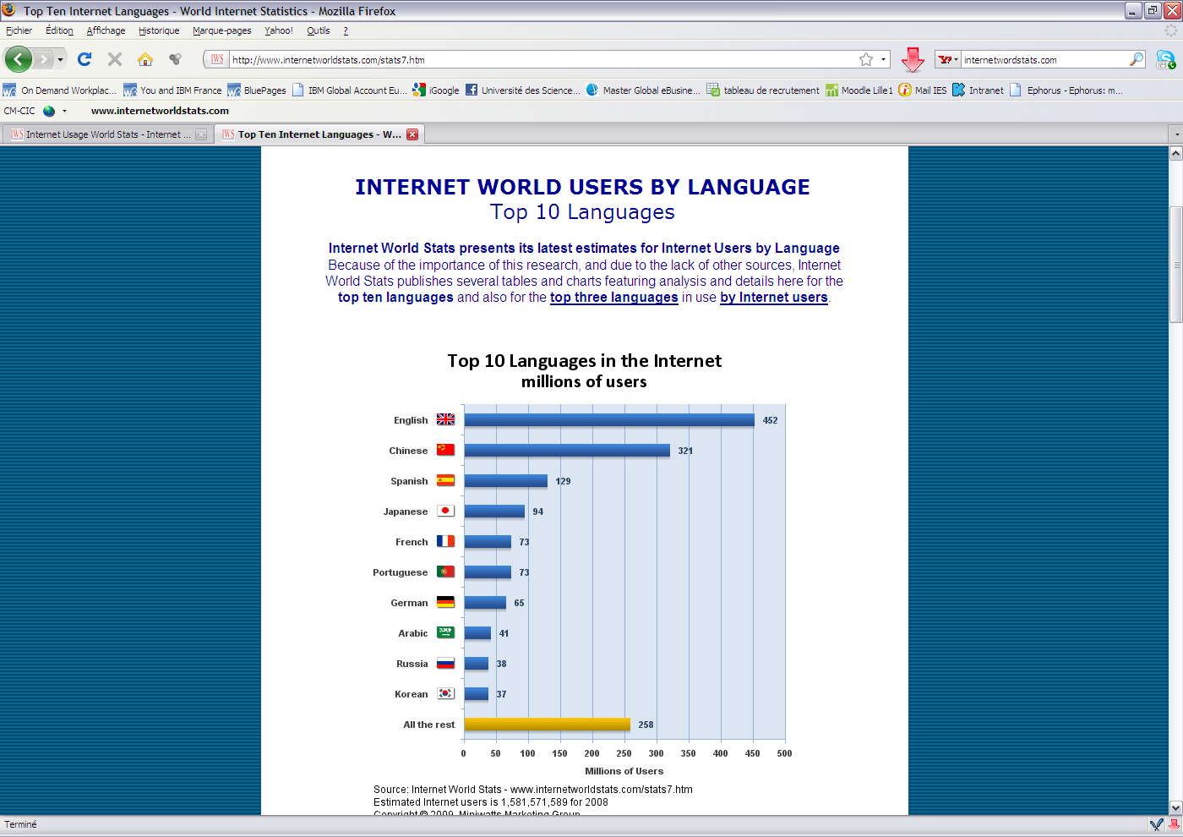

Slide 36
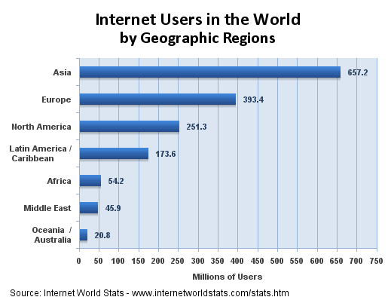

Slide 37
Handling conversations
Anglo-saxon :
Latin :
Oriental :
Notes:
Le type même de conversations varie d’une cuilture à l’autre : une distance entre personnes
De culture anglo-saxone existe, alors qu’il est de bon ton en culture latine de se rapprocher
Et de prendre la parole avant que l’autre ait terminé.

Slide 38
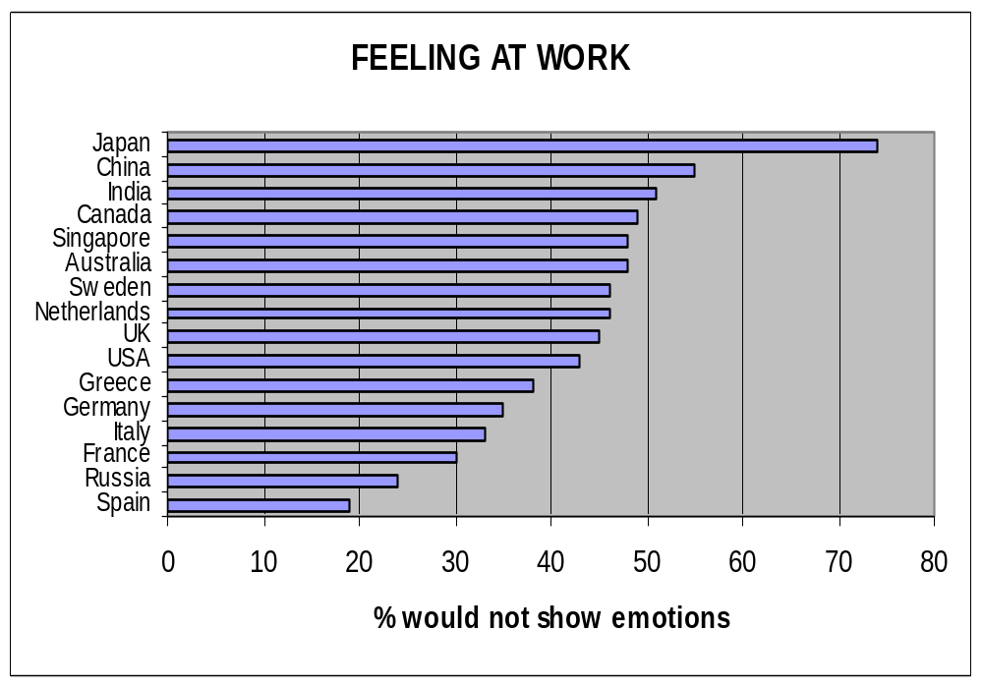
Notes:
Dans certains pays, on ne doit pas montrer ses émotions au travail…

Slide 39
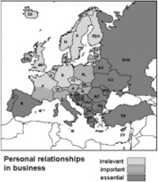
Europeans and personal relationship in business
From : « mind your manners »
Notes:
Dans le Nord de l’Europe, il n’est pas de bon ton de mêler vie privée et vie profesionnelle.

Slide 40
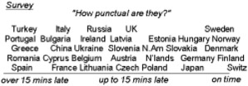
Europeans and ponctuality
From : « mind your manners »
Notes:
Pour certains nationaux, 15 minutes de retard sont acceptables. Pour d’autres,
C’est un affront !

Slide 41
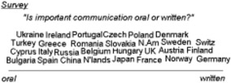
European attitude : Written vs Oral
From : « mind your manners »
Notes:
Dans certaines cultures, l’oralité des transactions suffit à les conclure.

Slide 42
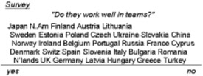
Europeans and teamwork
From : « mind your manners »
Notes:
Pour certains, le travail en équipe est naturel. Pour d’autres, non.

Slide 43
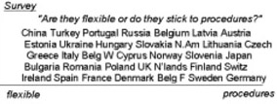
Europeans and procedures
From : « mind your manners »
Notes:
Certains ont besoin de procédures pour travailler efficacement. D’autres les inventent
Et avancent même sans directives.

Slide 44
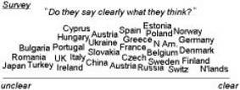
When Europeans say what they think
From : « mind your manners »
Notes:
Dans le Nord de l’Europe, on dit ce qu’on pense, crûment. Dans le Sud, on peut faire
Des mensonges pour ne pas blesser.

Slide 45
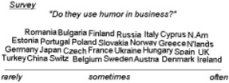
European Humour
From : « mind your manners »
Notes:
L’humour dans les affaires est indispensable dans le Nord de l’Europe. Dans les pays
Germanophones ou de la zone, c’est peu recommandé.

Slide 46
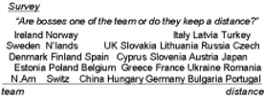
European Bosses in teams
From : « mind your manners »
Notes:
Certains nationaux voient leurs chefs avec distance, comme sur un piédestal.
D’autres voient tout le monde sur un pied d’égalité.

Slide 47
Management principles may have a different flavour in different cultures / religions
Lao Tseu : « Produce and grow, produce without owning, act without waiting, guiding without forcing, this is supreme Vertu »
Guendune Rinpoche : « nothing to do, nothing to force on, nothing to be expected…and then things will happen by themselves »
Muhamat Prophet : « Makhtoub ! » All things have been already written down.
Jesus Christ : « Dieu y pourvoiera » - God will give you everything you may need.
Bouddha : « the intelligent disciple will not fantasize about future, he will accept the present moment with an open mind »
…

Slide 48
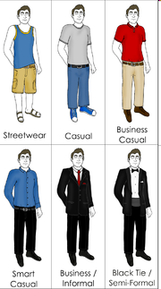
Dressing codes
In traditional Western dressing, for men the more formal dress codes, such as "black tie", are highly codified with essentially fixed definitions, mostly unchanged for more than fifty years, while the more casual classifications change very quickly, and a world-wide or widely relevant discussion is impossible.
For women, changes in fashion are more rapid.
In practical use, dress codes are either followed instinctively, enforced by peer pressure, so that people wear similar clothing in the same situations.
Courtesy Wikipedia

Slide 49
Casual Categories Chart
(suggested examples):
Casual Categories Chart (suggested examples):
Items Casual Code | Suit or Sport Jacket | Tie | Shirt | Jacket, vest and/or sweater | Trousers | Shoes | Belt
Business | Heavier fabrics and stronger patterns | (Optional) Heavier fabric or knit Fun pattern | Dress – patterns OK | Suit or Sport Sweater | Dressy (wool gabardine) | Lace ups Or Dressy loafers | leather
Country Club | Sport jacket | Not usually worn | Sport or Luxury long sleeved Tee | Sport or Casual Sweater | Dressy | Dressy loafers | leather
Sporty | Not usually worn | Not usually worn | Sport, knit, Denim, Flannel, Tee or Hawaiian | Casual Jacket (golf, jean, leather) and/or Sweater | Chinos Jeans (good condition) Cargo pants Cords | Deck, canvas, Athletic, Leather, or boots | Leather (wide, braided, rough texture or Cowboy)
Saturday | No | No | Tee/knit | Sweatshirt | Jeans Shorts | Athletic/ canvas/ sandals | Leather, Surcingle (canvas) or none
Active | No | No | Tee/Athletic | Casual jacket or sweatshirt | Shorts/ Sweats | Athletic/ canvas | Leather, Surcingle (canvas) or none
http://www.askandyaboutclothes.com/Clothes%20Articles/cracking_the_dress_code.htm

Slide 50
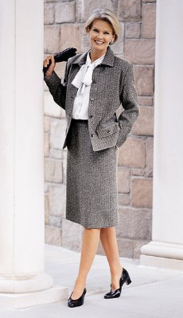
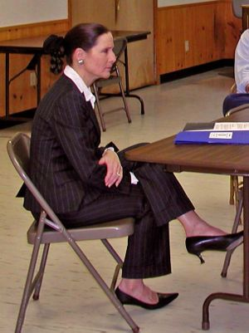
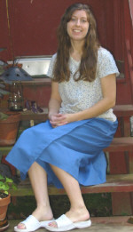
When Generations collide…
AT THE AMERICAN Library Association (ALA) meeting in Toronto, a telling generational shift was apparent--under the table.
The elegant Traditionalist librarian introducing the speakers wore a skirt, heels, and pantyhose.
The Baby Boomer speaker wore a pantsuit, sandals, and no stockings.
The Generation X librarian who participated in the panel discussion wore a short skirt and (horrors) flip-flops!
Kaboom—a generational collision at its finest!
Extract from article The Click and Clash of Generations By Lynne C. Lancaster. Boomer Lynne C. Lancaster is cofounder with Gen Xer David Stillman ofBridgeWorks, a consulting firm ( www.generations.com<http://www.generations.com> ). They co wrote When Generations Collide: Who They Are. Why They Clash. How To Solve the Generational Puzzle at Work (HarperBusiness, 2002), which documents the Generations T survey mentioned here
Notes:
Raised with instant access to information, Generation Xers are accustomed to frequent, immediate feedback. But they don't always get it. In our Generations survey, 30 percent of Xers said they receive their phone bill more often than they get relevant feedback on the job. That's a huge source of frustration.
Often.Traditionalists, however, raised with the attitude that "no news is good news" aren't always comfortable with the Xers' more "in-your-face"style.
Boomers, faced with 80 million peers competing for the same jobs, learned to handle feedback very formally, with yearly reviews and plenty of documentation in the file. Communication that's always "off the cuff“ can be frustrating.
When all these styles come together, it's easy to see how misunderstandings arise.
From wikipedia : http://en.wikipedia.org/wiki/Silent_Generation
The name Silent Generation was coined in the November 5, 1951 cover story of Time to refer to the generation coming of age at the time. The phrase gained further currency after William Manchester's comment that the members of this generation were "withdrawn, cautious, unimaginative, indifferent, unadventurous and silent." The name was used by Strauss and Howe in their book Generations as their designation for that generation in the United States of America born from 1925 to 1942. The generation is also known as the Postwar Generation and the Seekers, when it is not neglected altogether and placed by marketers in the same category as the G.I., or "Greatest", Generation. In England they were named the Air Raid Generation as children growing up amidst the crossfire of World War II.
According to Strauss and Howe's interpretation, the typical grandparents were of the Missionary Generation; their parents were of the Lost Generation and G.I. Generation. Their children are Baby Boomers and Generation X (a.k.a. 13th Generation) - or sometimes labeled as Generation Jones. Their typical grandchildren are of the Generation Y (a.k.a. Millennials.)
The Silent are the generational stuffings of a sandwich between the get-it-done but narcissistic G.I.s and the vocal self claimed world-changing Boomers. Well into their rising adulthood, they looked to the G.I.s for role models and pursued what then looked to be a lifetime of refining, humanizing, and ameliorating a G.I.-built world. Come the mid-1960s, the Silent fell under the trance of their free-spirited next-juniors, the Boomers. As songwriters, graduate students, and young attorneys, they mentored the Consciousness Revolution, founding several of the organizations of political dissent the Boom would later radicalize.
The Silent grew up as the suffocated children of war and depression. They came of age too late to be war heroes (they fought the Korean War to a tie) and just too early to be youthful free spirits. Instead, this early-marrying Lonely Crowd became the risk-averse technicians, sensitive rock-n-rollers ("Why must I be a teenager in love?") brooding Method actors and civil rights advocates of a post-Crisis era in which conformity seemed a sure ticket to success. Midlife was an anxious "passage" for a generation torn between stolid elders and passionate juniors. Their surge to power coincided with fragmenting families, cultural diversity, institutional complexity, and prolific litigation. In 2003, they are entering elderhood with unprecedented affluence, a hip style, and a reputation for indecision.
David Foot in Boom Bust and Echo takes a very different perspective on this group arguing that those born in the 1930s and early 1940s are the most successful generation. He argues that because so few people were born during the depression and the war that employment opportunities were abundant and this group quickly rose to the top and became the management and superiors of the great mass of baby boomers that came after them. Using economic indicators he finds that 1938 was the best year to be born in North America, in terms of economic success. The impact of the generation was also great culturally, as the musicians and thinkers such as Paul McCartney, John Lennon and Bob Dylan who shaped the fashions of the boomers and were often associated with the pop culture of the 1960s and 1970s.

Slide 51
Work Ethics are Impacted by Generational Values
Traditionalist in the Workplace (born before 1942) Value Duty, Tradition, and Loyalty Disciplined and committed Civic Minded Willing to reinvent themselves Demand Courtesy | Boomers in the Workplace (born 1943-1960) Value Individuality and Tolerance Change agents Drive to compete and excel Relationship oriented Hard work = Badge of Honor Searching their souls
Xers in the Workplace (born 1960-1980) Value Pragmatism, Being Savvy Independent Entrepreneurial Flexible and adaptable Outcome oriented I’m having a life – right now! | Gen Yers in the Workplace (born 1980-2000) Value Authenticity and Autonomy Digital natives Multi-taskers Collectivism is power Fewer gender or ethnicity issues Well educated
Ref. Lynn Busby, IBM, Feb 2007

Slide 52
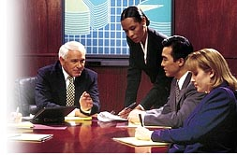
Cross-generational management : how to motivate people from various ages ?
Traditionalists (born before 1942) | Reward: The satisfaction of a job well done Motivate: Honor their hard work with plaques and other symbolic records of achievement.
Boomers (born 1943-1960) | Reward: Money, title, recognition, corner office Motivate: Assist them in gaining name recognition throughout the company.
Gen Xers (born 1960-1980) | Reward: Freedom is the ultimate reward Motivate: Give them lots of projects. Let them take control of prioritizing and juggling
Gen Yers (born 1980-2000) | Reward: Work that has meaning for me. Motivate: Open avenues for education and skill-building.
*Source: ”How Veterans, Baby Boomers, Generation Xers and Generation Nexters Can All Get Along in The Workplace”http://www.committment.com/getalong.html

